Slide 1
Interacting Dynamic Processes for Social Network Data
Katherine Heller
Center for Cognitive Neuroscience
Department of Statistical Science
Department of Computer Science
Department of Neurobiology
Department of Neurology

Slide 2
My Research Areas
Machine Learning for Healthcare
Social Network Modeling
Jointly Modeling Diverse Data Sets
Neuroscience
Chronic Kidney Disease
Bayesian time series models
Cognitive Science Applications with Bayesian Nonparametrics
Bayesian Clustering
Topic/language modeling

Slide 3
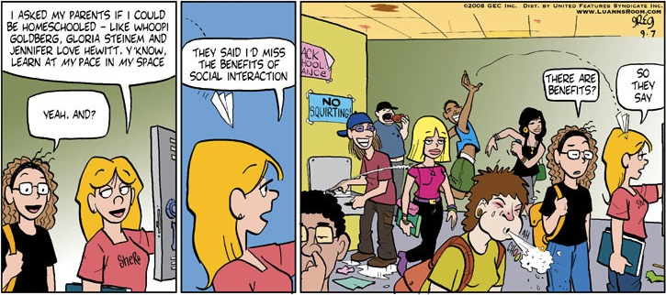
Social Interactions
Fundamental to understanding human behavior.
Very complex.
Ideal for interdisciplinary research.
Notes:
Recent research has indicated that people spend a great deal of their lives socializing, or interacting with other people. Since social interactions make up so much of our lives, understanding them is a fundamental part of understanding human behavior. We’d like to be able to make better predictions about people’s social behavior, and possibly to improve the interactions in order to make them more beneficial. Social interactions are very complex so analyzing and modeling them is not an easy task. This is a good area for interdisciplinary research going forward, which can benefit both from the modeling know-how of statisticians and computer scientists, and a deeper understanding of the subtleties of human behavior studied by cognitive and social scientists.
Why analyze?

Slide 4
Outline
Hawkes Processes and the Bayesian Echo Chamber
Modeling the Spread of Disease with Graph-coupled HMMs
Other Machine Learning for Healthcare Work

Slide 5
Reciprocating Relationships
People organize into social groups.
We’d like to know the dynamics of these groups.
But these groups are not explicitly defined.
Can use declared relationships (e.g. fb friends) to infer groups.
However not always available, truthful, or useful.
We infer groups from real interactions.
Data is a sequence of many events - actions from a sender to a receiver.
Leverage reciprocity patterns to discover social groups.
Notes:
People constantly organize themselves into social groups. These groups can revolve around an activity (sports team), a role (manager), or general social alliances (gang member). Understanding the dynamics of social groups is difficult. One problem is that groups are often not explicitly defined. We’d like to be able to infer these groups and make predictions about individual interactions based on them. Commonly, people use declared relationships (fb friends) to infer groups. However, these declared relationships aren’t always readily available, truthful, or useful for the social group structure of interest. In this work we want to infer social groups from real interactions between people. “actions speak louder than words” philosophy. >> Here our data consists of a sequence of many events in which a sender performs an action towards a recipient at some point in time. Actions might be sending an email or speaking. The property we use to infer social groups is reciprocity – where one person’s action towards another increases the chance of a response. When multiple people have the same reciprocity pattern, they’re put in the same group.
----- Meeting Notes (11/5/12 13:27) -----

Slide 6
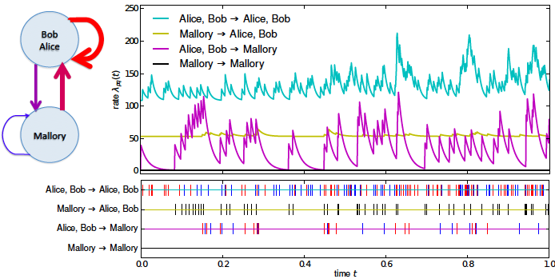
Reciprocating Relationships
Notes:
expected rate of events between pairs of clusters. Alice and bob positively reciprocate each others actions. Mallory has an asymmetric relationship – takes more events from her to get a response, and responses from a+b are sparser.

Slide 7
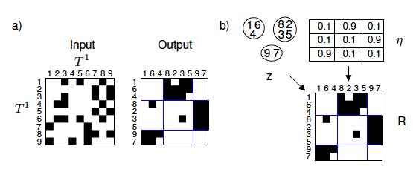




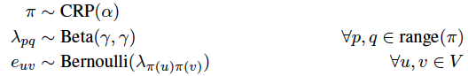
Infinite Relational Model
The IRM is a method for clustering entities based on graphs of declared relationships.
Kemp et al

Slide 8



Poisson Process IRM
Often interaction data contains many interactions between the same pair of individuals.
Cannot be modeled with a vanilla IRM.
Can modify to use Gamma-Poisson observation model.
But then we cannot predict events into the future.
Therefore we consider a Poisson process.

Slide 9
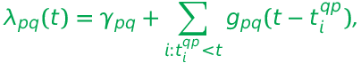
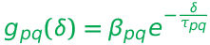
Hawkes Processes
Drawbacks of using the Poisson Process:
Rate of events between pairs of clusters independent of all other pairs.
Times of events are uniformly distributed.
Instead use a mutually-exciting Hawkes process:
p➔q
λ
γ
q➔p
t

Slide 10
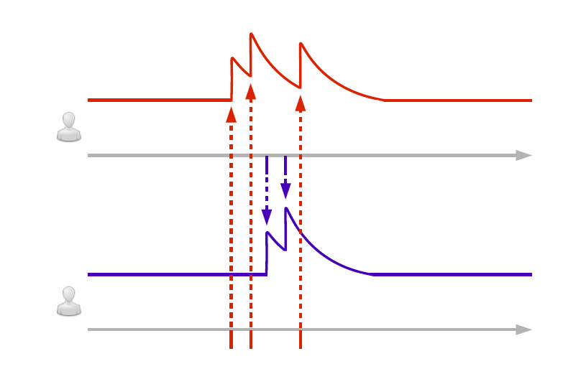
Multivariate Hawkes Process

Slide 11
Inference
Posterior inference is performed using MCMC.
Unlike previous IRM models there is no conjugate prior for the likelihood.
Must sample parameters instead of integrating out.
We infer the partition of entities, CRP concentration parameter, and Hawkes process parameters using Metropolis within Gibbs and Slice sampling.
Basically Neal’s algorithm 5 with some additional slice sampling.

Slide 12
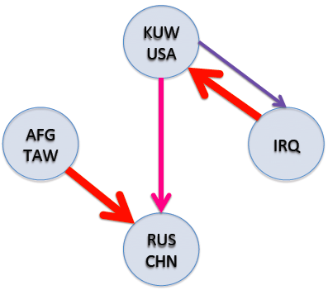
Experiments: Correlates of War
Militarized Interstate Disputes data set which captures correlates of war.
Data: Years 1993-2001, all MID incidents and countries involved.
Incidents vary from diplomatic threats to deployment of force.
3 main conflicts
Russia and Afghanistan
Taiwan and China
USA, Iraq and Kuwait
Blundell et al, NIPS 2012
Notes:
82 countries full.
Taiwan (sometimes with support from the
USA) and China (sometimes with support from Russia), and 3) Iraq, Kuwait, and the USA. 1)
Revolved mostly around border disputes coming out of the Soviet war in Afghanistan, and incidents
sometimes involved using former Soviet countries as proxies. 2) Reflects conflict between Taiwan
and China over potential Taiwanese independence. Lastly, 3) deals with conflicts between Iraq and
either Kuwait or the USA coming out of the Persian Gulf war.

Slide 13
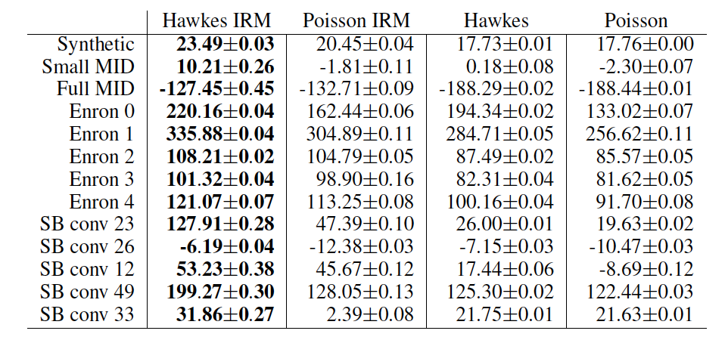
Experiments:
Log predictive probabilities of events falling in the last 10% of time.
Also Enron data – 5 longest threads.

Slide 14
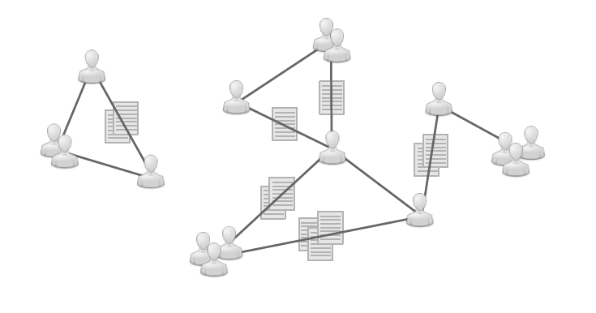
Bayesian Echo Chamber
Look at how people influence each other.

Slide 15
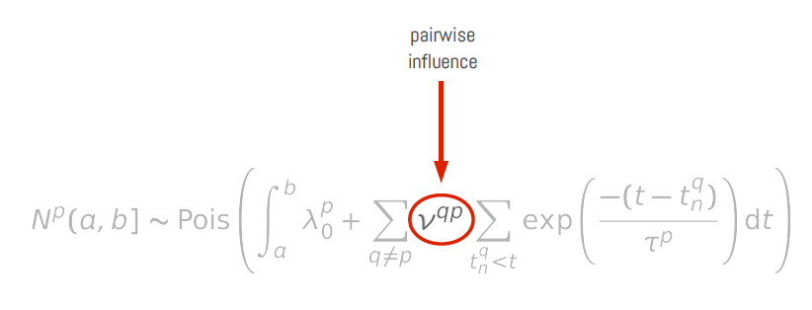
Temporal Influence

Slide 16
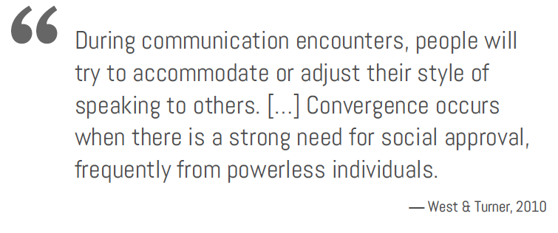
Linguistic Accommodation

Slide 17
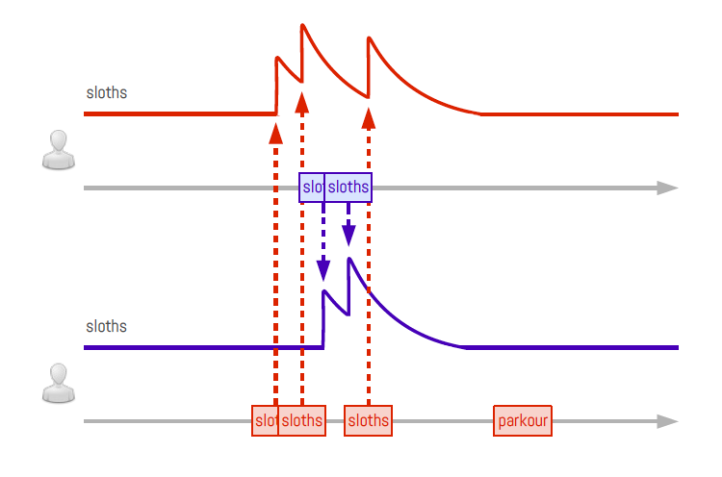
Mutually Exciting Language Models

Slide 18
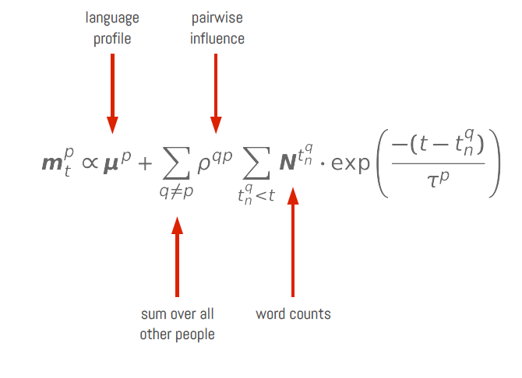
For each person…

Slide 19
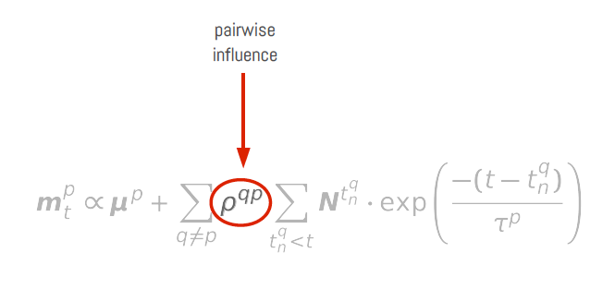
Linguistic Influence

Slide 20
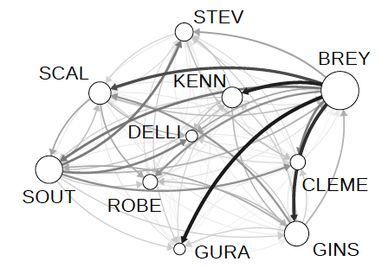
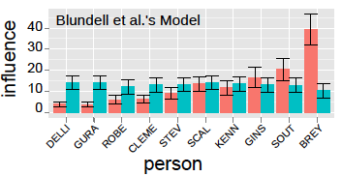
DC v Heller: Temporal Influence
Guo et al, AISTATS 2015

Slide 21
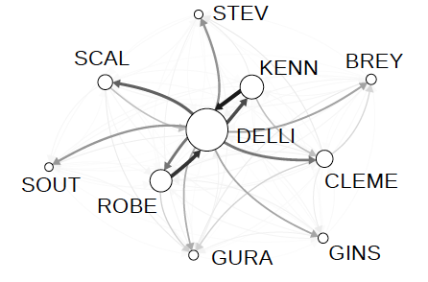
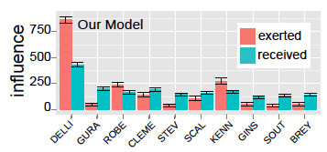
DC v Heller: Linguistic Influence
Guo et al, AISTATS 2015

Slide 22
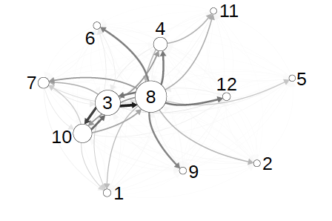
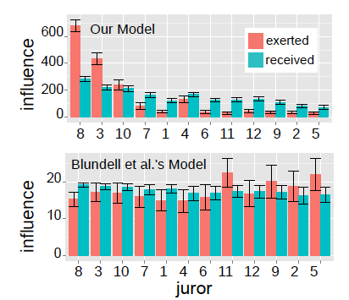
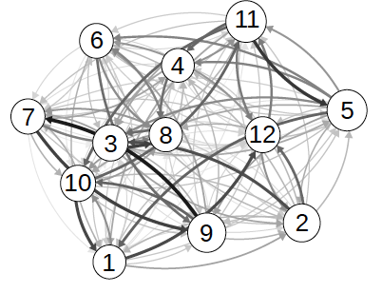
12 Angry Men

Slide 23
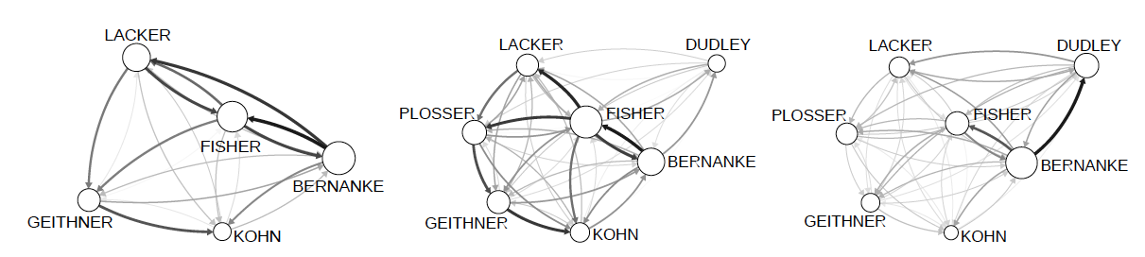
Federal Reserve Board Meetings
Guo et al, AISTATS 2015

Slide 24
Relating Time and Content
Allow the amount of excitation to be dependent on content in an event based Hawkes process with IRM.
Results in improved log likelihood on held out test data (enron, santa barbara conversation corpus, citation), and more intuitive clusters.
Tan et al, UAI 2016

Slide 25
Extensions
Learning clusterings of neurons. Similar processes are used in neuroscience to model the activation and co-activation of neurons. These usually also involve inhibition, but don’t directly cluster.
Scale up inference
Deal with unknown recipients
Online bullying

Slide 26
Infection in a Social Network
Goal: To model dynamical interactions between agents in a social network and apply to inferring the spread of infection.
Many traditional epidemics models work on a population level, treating each person the same way.
Contemporary data collection techniques allow us to model the spread of infection on an individual level.
Being able to make infection predictions on an individual level is enormously beneficial because it allows people to receive more personalized and relevant health advice.

Slide 27
Social Evolution Experiment
Data collected in the social evolution experiment allows us for the first time to closely track proximities and contagion in an entire community over a substantial period of time.
Tracked “common cold” symptoms in an MIT residence hall from January to April 2009.
Monitored over 80% of residents through their cell phones from October 2008 to May 2009, taking daily surveys and tracking their location, proximities and phone calls.
Monthly surveys on social, health, and political issues taken. Locations taken by having cell phones scan nearby wifi access points and bluetooth devices.

Slide 28
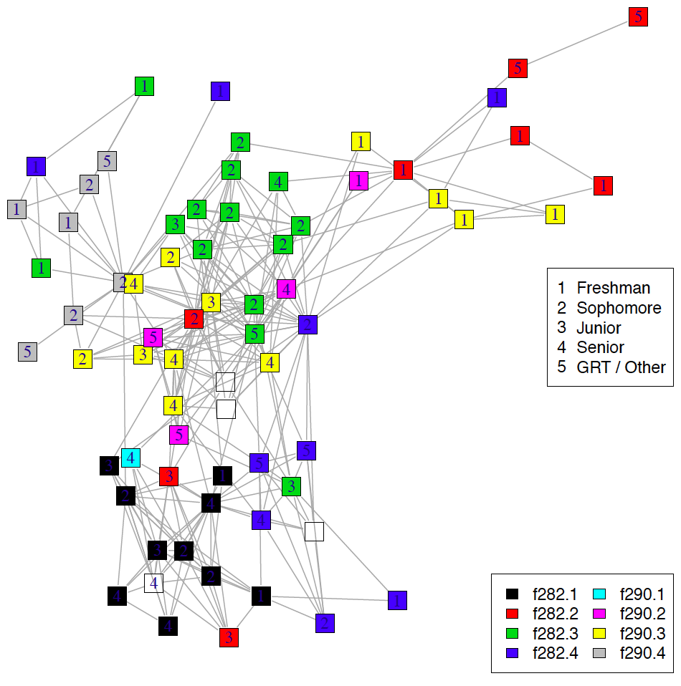
Student Hall Network

Slide 29
Health Surveys
In the Social Evolution experiment students were paid $1 a day to answer surveys about contracting infection.
The surveys asked about symptoms:
Runny nose, nasal congestion, sneezing
Nausea, vomiting, diarrhea
Stress
Sadness and depression
Fever
64 of the 85 residents answered the surveys
Symptoms dependent on the social network. A student with a symptom had a 3-10x higher odds of having a friend with the same symptom.

Slide 30

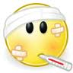
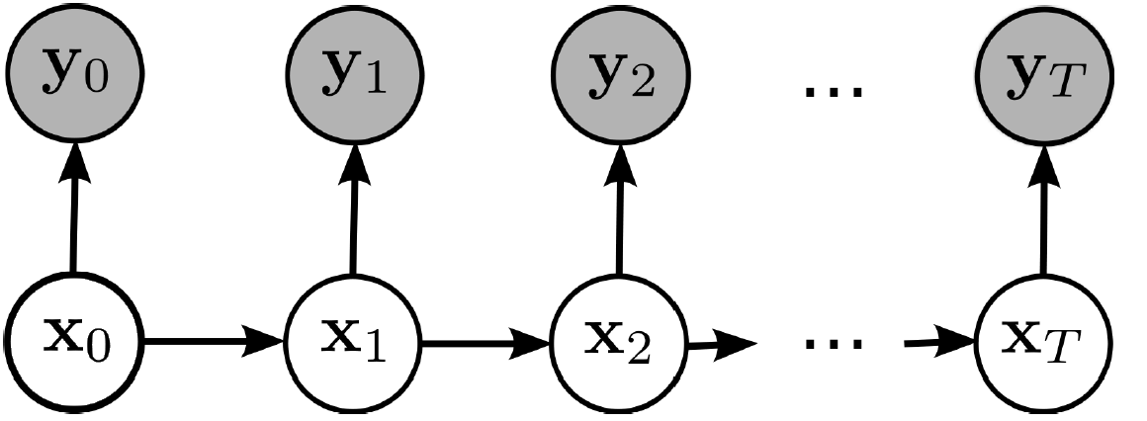
Hidden Markov Models
We aim to leverage the social evolution data to predict the spread of infection to individuals in our social network using a model related to HMMs.

Slide 31
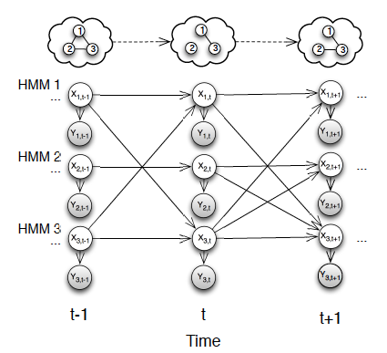




Graph-coupled HMMs
Associate each person in the dynamic interaction network with an HMM chain. Let interaction network structure determine the HMM couplings:

Slide 32
GCHMM Inference
Inference in the coupled HMM is very hard.
Typically ML estimation is done on few chains with few states or another approximation is made.
In the worst case GCHMM inference is as difficult as CHMM inference.
When the graph is fully connected.
Fortunately, since we’re dealing with social networks we can leverage a couple of properties:
Social networks are usually sparse
For many applications the influence of interactions can be modeled in a fairly simple way via a small number of parameters.

Slide 33
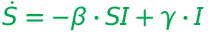
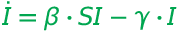








GCHMMs for Modeling Infection
In the case of the social evolution data the influence of other HMMs can be summarized by counts of interactions in the infectious state.
The GCHMM can provide an individual level version of the susceptible-infectious-susceptible (SIS) epidemiology model:
GCHMM for infection:

Slide 34
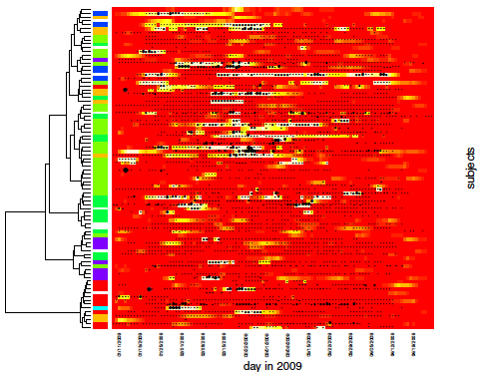
Experimental Results
Dong et al, UAI 2012

Slide 35
Aiello Group Data
eX-FLU study at University of Michigan
590 students from 6 dorms
Chain referral scheme
A 103 student subset participated in iEpi
Smartphone based study where location is tracked and surveys taken
Unlike MIT study confirmation of interaction was recorded on phones and flu testing was done on students who reported being ill.
Also an isolation intervention was tested.

Slide 36
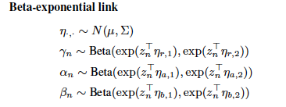
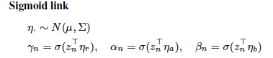
Hierarchical GCHMMs
Add a hierarchical level to where beta distributed infection parameters are learned:
Inference Gibbs-EM algorithm but follow up papers e.g. stochastic VB

Slide 37
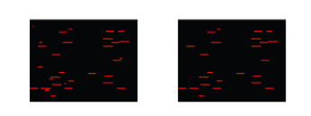
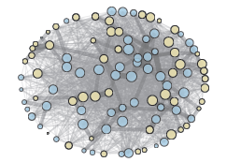
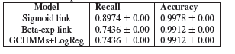
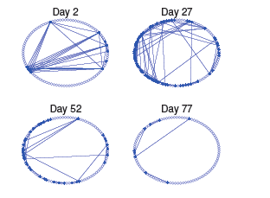
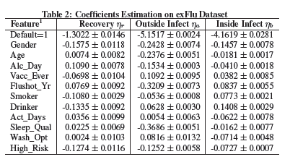
Results
Fan et al, KDD 2016

Slide 38
Extensions
Other applications of the GCHMM to network data, like modeling the influence of opinions.
Scale up to larger communities (Fan et AAAI 2016)
Nonparametric Bayesian extensions
Other factors that may influence contracting an infection
Learn latent network structure

Slide 39
More ML for Healthcare Work

Slide 40
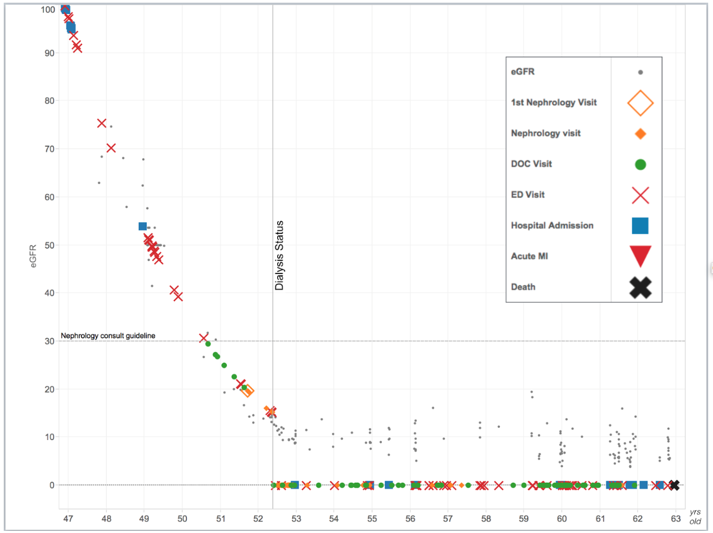
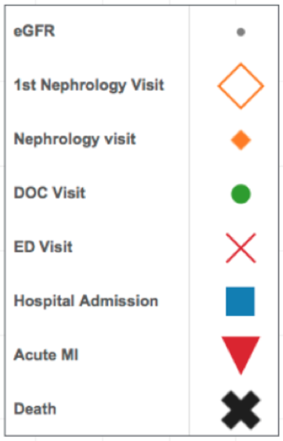
eGFR
Kidney Function
(eGFR)
1st Nephrology Visit
Nephrology Visit
PCP Visit
ED Visit
Hospital Admission
Acute MI
Age
Death
Notes:
I’l start by telling you a story about Bob.
Not his real name of course.
But Bob is a real person.
Bob’s percent kidney function is on the y axis 0-100.
Bob’s age is on the x-axis starting at age 47
The legend over shows the different types of events and medical care Bob receives

Slide 41
Age 47
Untreated diabetes & high blood pressure.
Normal kidney function, but with evidence of kidney damage.
No regular medical care.
eGFR
1st Nephrology Visit
Nephrology Visit
PCP Visit
ED Visit
Hospital Admission
Acute MI
Death
Notes:
Bob first meets Duke health system about 15 years ago at age 47.
Bob shows up at the ED about a half-dozen times, gets a battery of tests.
We collect enough data on Bob to know that he has
Uncontrolled diabetes and HTN
He has normal kidney function but evidence of kidney damage

Slide 42
eGFR
1st Nephrology Visit
Nephrology Visit
PCP Visit
ED Visit
Age 49 Kidney function now 50%
Hospital Admission
Acute MI
Death
Notes:
After a couple of years and visits the ER his kidney function has fallen by half.

Slide 43
eGFR
1st Nephrology Visit
Nephrology Visit
PCP Visit
ED Visit
Hospital Admission
Acute MI
Death
Age 51
Referred to
kidney specialist
Notes:
He finally sees a kidney specialist after 5 consistent years of decline

Slide 44
eGFR
1st Nephrology Visit
Nephrology Visit
PCP Visit
ED Visit
Dialysis Begins
Hospital Admission
Acute MI
Death
Three months later presents to ER with kidney failure symptoms and “crash starts” dialysis
Notes:
Three months after that visit
Bob starts hemodialysis

Slide 45
eGFR
1st Nephrology Visit
Nephrology Visit
PCP Visit
ED Visit
Dialysis Begins
Hospital Admission
Acute MI
Death
Notes:
He spent 10 years on dialysis and died last year at the age of 63.

Slide 46
eGFR
Missed Opportunities:
To prevent or delay kidney failure
To prepare for kidney failure
1st Nephrology Visit
Nephrology Visit
PCP Visit
ED Visit
Hospital Admission
Acute MI
Death
Notes:
Bob missed out.
He didn’t get treatment that could have slowed his progression and prolonged his life.
He didn’t get any warning that his life would be turned upside-down.
Nothing to smooth his transition.
But this isn’t just about Bob.
This was a missed opportunity for every taxpayer now footing the bill for all this expensive medical care.

Slide 47
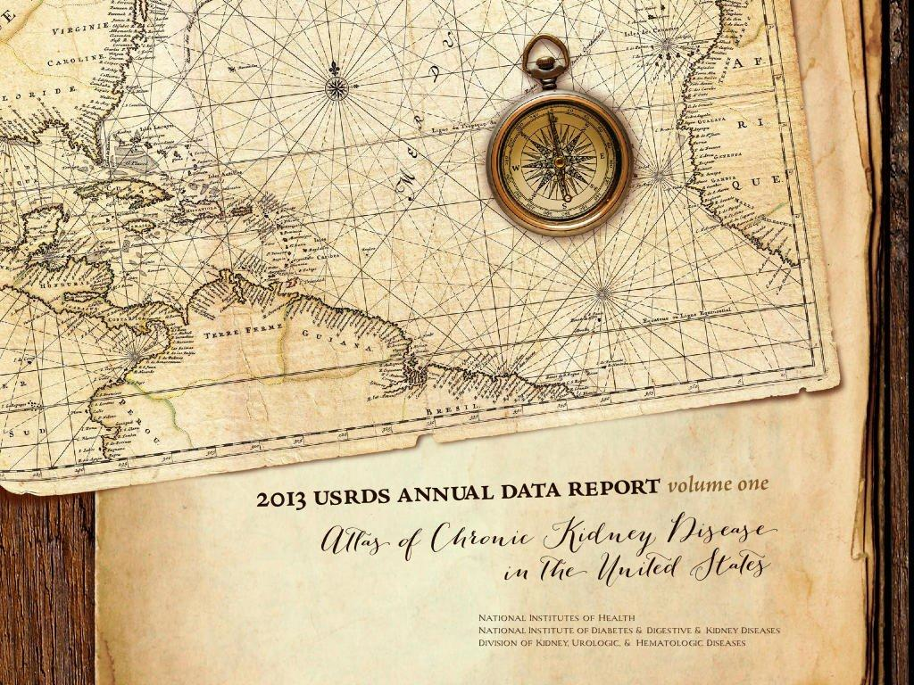
<10% with moderate CKD <50% with severe CKD
even aware of illness!
Notes:
Where the majority of people with CKD don’t even know they have the disease.
Of course, seeing a kidney specialist is not a guarantee of a smooth transition to dialysis.
Even specialists struggle to predict how fast patients will progress.

Slide 48
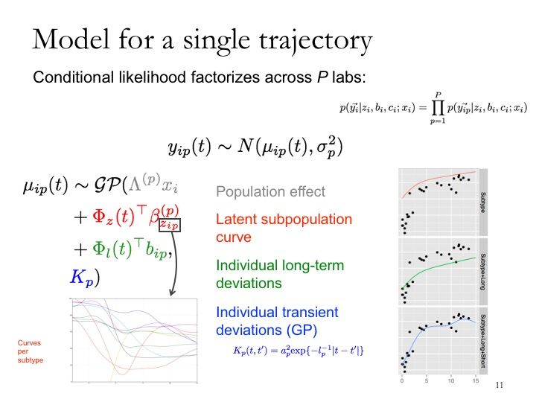
Futoma et al, MLHC 2016

Slide 49
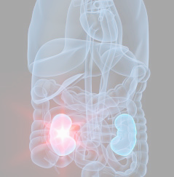
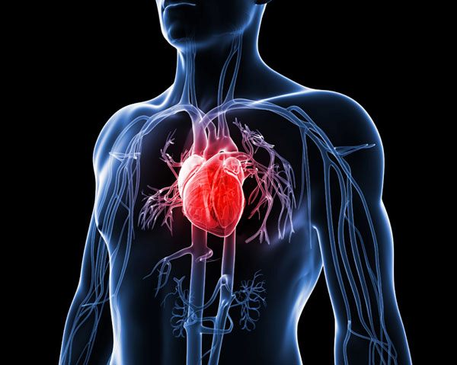
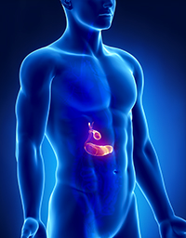
Chronic Kidney Disease (CKD)
Heart disease
Diabetes

Slide 50
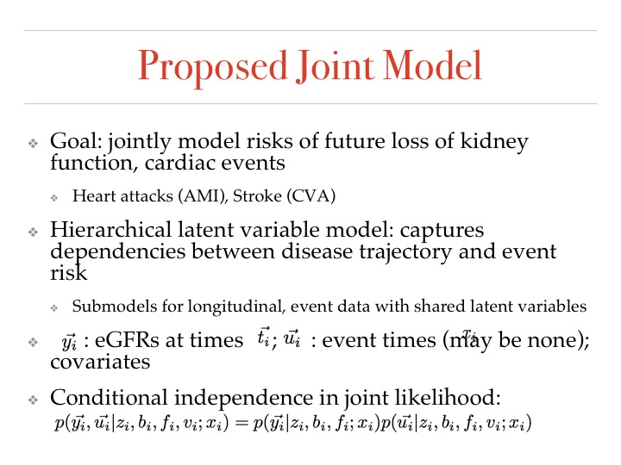
Futoma et al, UAI 2016

Slide 51
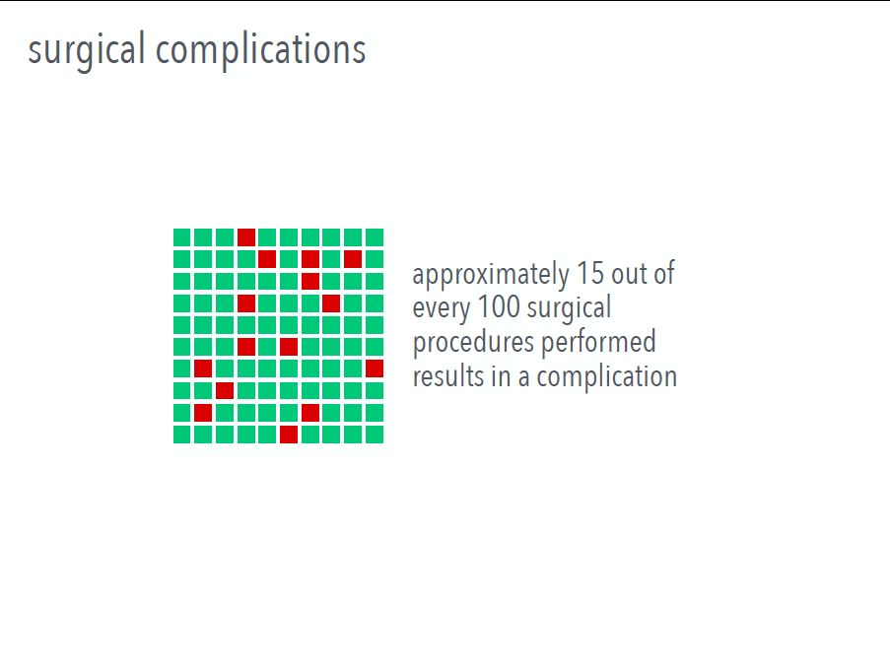

Slide 52


Slide 53
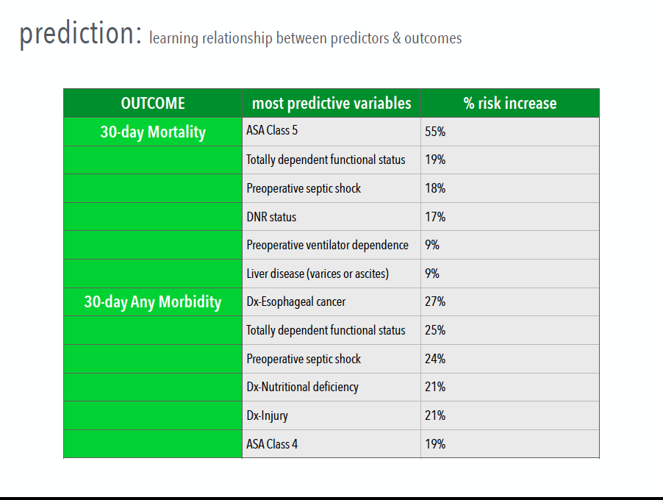

Slide 54
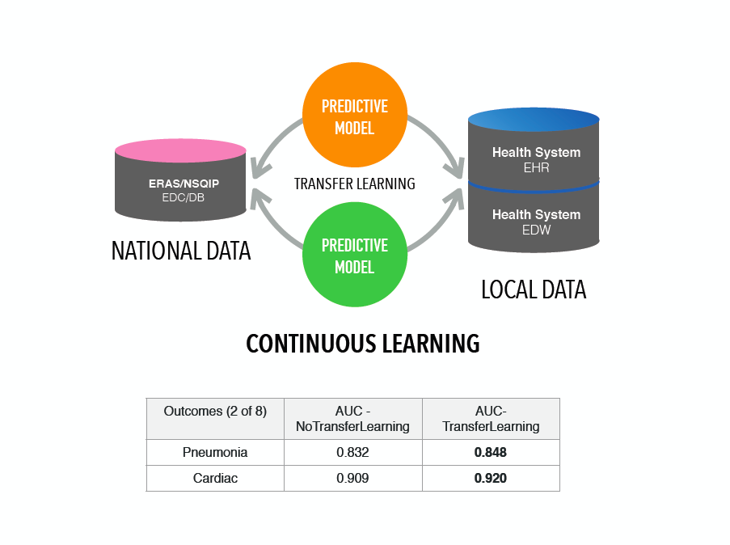

Slide 55
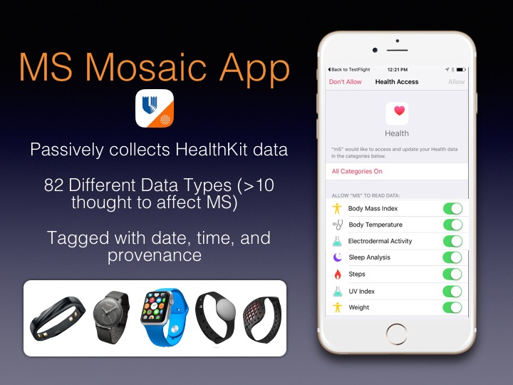

Slide 56
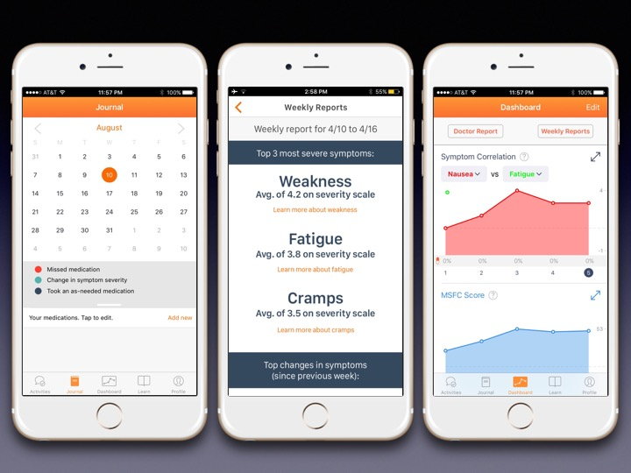

Slide 57


Slide 58
Future Work
Further work in machine learning for health care
Sepsis
Congestive Heart Failure
Surgical Transplants
Implement infectious disease work locally
Develop models for data from more diverse sensors
Causal Inference
Additional sensors on other groups related to physiometrics
Does heart rate impact basketball players shot percentage
Other social network applications – like online bullying
Other joint modeling applications – measuring diverse data sets from e.g. different sensory modalities (and animals) to infer functional neural networks in the brain.

Slide 59
Future Work
Role of other media in ability to make health predictions
Xbox
Cortana
Bing
Incorporation of Microsoft Health devices into research
Microsoft Band
Development of machine learning for Microsoft apps
HealthVault Insights
Incorporation of behavior and choice into patient feedback
Medication Adherence
Exercise
Health bot
Joint modeling of Microsoft data with other data (e.g. NIH)

Slide 60
Collaborators
Charles Blundell Kai Fan Joseph Futoma
Hanna Wallach Allison Aiello Elizabeth Lorenzi
Richard Guo Marissa Eisenberg Blake Cameron
Alan Qi Alison Walsh Mark Sendak
Vinayak Rao Sandy Pentland Lee Hartsell
Xi Tan Wen Dong Erich Huang
Syed Naqvi Jeff Sun
Jerry Zhu Sanjay Hariharan
Wei Zhang
Fan Bu

